Slide 2
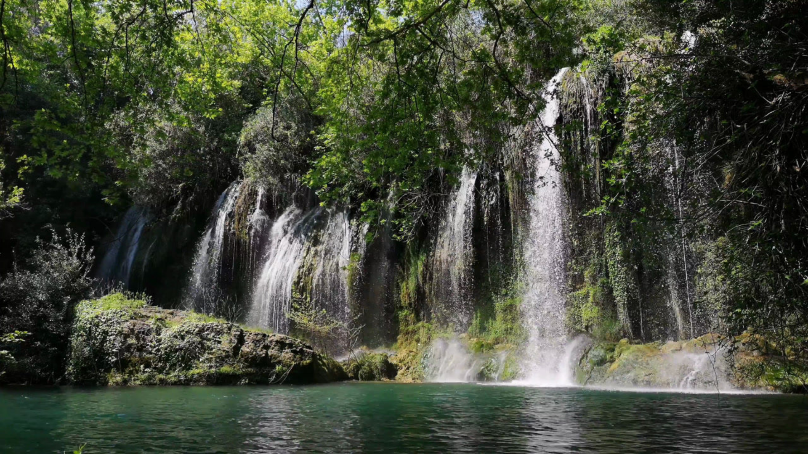
Chapter 14
Eve Disbelieved God

Slide 3
IF Eve had believed the word of God, she would never have sinned. Yea, so long as Eve had believed the word of God, she never could have sinned. All who will think must agree that this is true.
She had the word of God plainly expressed: "Of the tree of the knowledge of good and evil, thou shalt not eat of it: for in the day that thou eatest thereof thou shalt surely die."
LIVING BY FAITH: CHAPTER 14 – EVE DISBELIEVED GOD

Slide 4
Satan came with his new word, his arguments and persuasions: "Ye shall not surely die; for God doth know that in the day ye eat thereof, then your eyes shall be opened, and ye shall be like God, knowing good and evil."
LIVING BY FAITH: CHAPTER 14 – EVE DISBELIEVED GOD

Slide 5
If, then, Eve had said: "No; God has said that I must not eat of that tree. He has said that in the day I eat of it I shall die. I believe God. I do not claim to know all about it, but he does know all about it. I will trust him. I will not eat of that tree,"—had she so done, she would never have sinned. And so long as she had so done, she could not have sinned.
LIVING BY FAITH: CHAPTER 14 – EVE DISBELIEVED GOD

Slide 6
Therefore it is everlastingly true that had Eve believed God, she never would have sinned; and so long as she had believed God, she never could have sinned. And Adam the same.
LIVING BY FAITH: CHAPTER 14 – EVE DISBELIEVED GOD

Slide 7
Now that thing is just as true to-day as it was that day; and it is as true of every man and woman to-day as it was of that woman that day. The person to-day who believes God, will not sin; and so long as he believes God, he can not sin.
This principle is eternal, and is as good to-day as it was in the beginning. And Christ in human nature has demonstrated it.
LIVING BY FAITH: CHAPTER 14 – EVE DISBELIEVED GOD

Slide 8
But this calls for really believing God,—not a pretended believing, that apparently accepts one word of the Lord and rejects another; that professes to believe one statement of the word of God, and doubts the next one. That way of doing is not believing God at all.
LIVING BY FAITH: CHAPTER 14 – EVE DISBELIEVED GOD

Slide 9
But whoever abhors sin, whoever would rather die than to sin,—to him the word of God is precious; to him it is a pleasure, yes, a joy, to study to find all the Lord has spoken; with him there is a hungering and thirsting that will gladly receive the word of God, that he may not sin.
LIVING BY FAITH: CHAPTER 14 – EVE DISBELIEVED GOD

Slide 10
"Concerning the works of men, by the word of thy lips I have kept me from the paths of the destroyer."
"Thy words were found, and I did eat them; and thy word was unto me the joy and rejoicing of mine heart."
"Study to show thyself approved unto God." "Let the word of Christ dwell in you richly."
"Thy word have I hid in mine heart, that I might not sin against thee."
LIVING BY FAITH: CHAPTER 14 – EVE DISBELIEVED GOD

Slide 11
And so shall you indeed be "kept by the power of God through faith unto salvation ready" now "to be revealed," because it is the last time.
LIVING BY FAITH: CHAPTER 14 – EVE DISBELIEVED GOD

