Slide 2
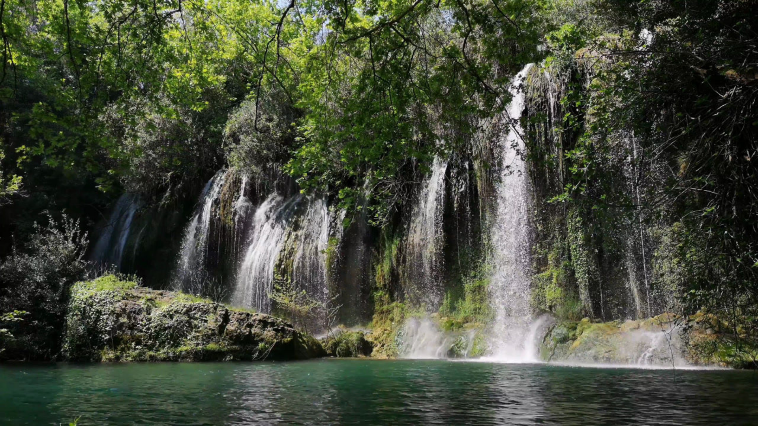
Chapter 16
As Free As a Bird

Slide 3
The Lord Jesus Christ began His earthly ministry by reading in the synagogue at Nazareth the following words from Isaiah: "The Spirit of the Lord is upon Me, because He hath anointed Me to preach the Gospel to the poor; He hath sent Me to heal the brokenhearted, to preach deliverance to the captives, and recovering of sight to the blind, to set at liberty them that are bruised, to proclaim the acceptable year of the Lord." Luke 4:18, 19. And then He said to the congregation, "This day is this scripture fulfilled in your ears."
LIVING BY FAITH: CHAPTER 16 – AS FREE AS A BIRD

Slide 4
Turning to the place from which Christ read, we find these words: "The Spirit of the Lord God is upon Me; because the Lord hath anointed Me to preach good tidings unto the meek; He hath sent Me to bind up the brokenhearted, to proclaim liberty to the captives and the opening of the prison to them that are bound." Isa. 61:1.
LIVING BY FAITH: CHAPTER 16 – AS FREE AS A BIRD

Slide 5
The Hebrew term which in Isaiah is rendered, "the opening of the prison," has the general signification of "opening," and is applied to the opening of the eyes of the blind, and the ears of the deaf. Accordingly the Saviour gave it this double application, in reading it, so that in Luke we have instead of the one statement, "the opening of the prison to them that are bound" the two statements, "recovering of sight to the blind," and, "to set at liberty them that are bruised."
LIVING BY FAITH: CHAPTER 16 – AS FREE AS A BIRD

Slide 6
The whole import of the text therefore is that Christ came to give freedom in every sense of the word. It is charged with the idea of liberty, and that to an extent that few realise. We shall be amply repaid for a few moments closer study of it, and for many hours of meditation upon it afterwards.
LIVING BY FAITH: CHAPTER 16 – AS FREE AS A BIRD

Slide 7
The word "liberty," in the statement, in Isa. 61:1, that Christ was anointed "to proclaim liberty to the captives," is from a Hebrew word, the primary 49 signification of which is "a swallow." This noun is derived from a verb which signifies "to fly in a circle, to wheel in flight," like a bird in the air. From this it is easy to see how the word came to signify "freedom" and "liberty."
LIVING BY FAITH: CHAPTER 16 – AS FREE AS A BIRD

Slide 8
We learn, therefore, that the Bible idea of liberty is best represented by the graceful flight of a swallow through the air. We often use the figure, "as free as a bird," and that exactly expresses the liberty wherewith Christ makes us free. Is it not a glorious thing? What a sense of freedom thrills the soul at the very thought of it!
LIVING BY FAITH: CHAPTER 16 – AS FREE AS A BIRD

Slide 9
Sin is bondage. Jesus said, "Verily, verily I say unto you, Every one that committeth sin is the bondservant of sin." John 8:34. Not only is the sinner in bondage, but he is in prison. The Apostle Paul says, "The Scripture hath concluded all under sin, that the promise by faith of Jesus Christ might be given to them that believe. But before faith came we were kept under the law, shut up unto the faith which should afterwards be revealed." Gal. 3:22, 23. The word "concluded" means, literally, "shut up together." All sinners are in bondage, shut up together in prison, condemned to hard labour.
LIVING BY FAITH: CHAPTER 16 – AS FREE AS A BIRD

Slide 10
The end of sin is death. James 1:15. Consequently the sinner is not only shut up in prison, condemned to hard, unprofitable labour, but he has the fear of death continually before him. It is from this that Christ delivers us. See Heb. 2:14, 15. So we read in Ps. 102:19, 20, "For He hath looked down from the height of His sanctuary; from heaven did the Lord behold the earth; to hear the groaning of the prisoner, to loose those that are appointed to death." Christ says, "If the Son therefore shall make you free, ye shall be free indeed." John 8:36.
LIVING BY FAITH: CHAPTER 16 – AS FREE AS A BIRD

Slide 11
"Free indeed." With the knowledge already gained from Isa. 61:1, we can easily grasp the fulness of that freedom. Imagine a bird that has been caught, and shut up in a cage. It longs for freedom, but the cruel bars 50 make that impossible. Someone comes along and opens the door.
LIVING BY FAITH: CHAPTER 16 – AS FREE AS A BIRD

Slide 12
The bird sees the opening, but has so often been deceived in his attempts to gain his liberty, that he hesitates. He hops down finds that his prison is really open, trembles a moment for very joy at the thought of liberty, then spreads his wings and wheels through the air with such rapture as can be known only by one who has been a captive. "Free indeed."
As free as a bird.
LIVING BY FAITH: CHAPTER 16 – AS FREE AS A BIRD

Slide 13
But it is the truth that gives this freedom; for Christ says, "Ye shall know the truth, and the truth shall make you free." John 8:32. He is the truth, and His word is truth. The Psalmist says, "Thy righteousness is an everlasting righteousness, and Thy law is the truth." Ps 119:142. And he also says, "I will walk at liberty, for I seek Thy precepts." Ps. 119:45.
LIVING BY FAITH: CHAPTER 16 – AS FREE AS A BIRD

Slide 14
As we learn from the margin, this is literally, "I will walk in a broad place, for I seek Thy precepts;" and this fits with what we learn in verse 96: "I have seen an end of all perfection; but Thy commandment is exceeding broad." The commandments of God form an exceedingly broad place in which all may walk who seek them. They are the truth, and it is the truth that gives freedom.
LIVING BY FAITH: CHAPTER 16 – AS FREE AS A BIRD

Slide 15
"The law is spiritual." Rom. 7:14. That is, the law is the nature of God, for "the Lord is that Spirit; and where the Spirit of the Lord is, there is liberty." 2 Cor. 3:17. Because the Spirit of the Lord God was in Christ, He could proclaim liberty to the captives of sin. So we read the words of one who had been a captive slave, "sold under sin:" "There is therefore now no condemnation to them which are in Christ Jesus, who walk not after the 51 flesh, but after the Spirit. For the law of the Spirit of life in Christ Jesus hath made me free from the law of sin and death." Rom. 8:1, 2.
LIVING BY FAITH: CHAPTER 16 – AS FREE AS A BIRD

Slide 16
The law of God was, and is, in the heart of Christ. Ps. 40:8. Out of the heart are the issues of life (Prov. 4:23); therefore the life of Christ is the law of God. When men attempt to keep the law in their own strength, they invariably get into bondage, just as surely as though they wilfully broke it. The only difference is that in the latter case they are willing slaves, while in the former they are unwilling slaves.
LIVING BY FAITH: CHAPTER 16 – AS FREE AS A BIRD

Slide 17
In Christ alone the perfect righteousness of the law is found, and therefore His life is "the perfect law of liberty," into which we are exhorted continually to look. James 1:25; Heb. 12:2. The law that shuts up to certain death the man who is out of Christ, becomes life and liberty to the man who is in Christ.
LIVING BY FAITH: CHAPTER 16 – AS FREE AS A BIRD

Slide 18
We have seen that the "commandment is exceeding broad." How broad?- Just as broad as the life of God. Therefore the liberty, or the "broad place" in which one can walk who seeks the law of God, is the breadth of God's mind, which comprehends the universe. This is "the glorious liberty of the children of God."
LIVING BY FAITH: CHAPTER 16 – AS FREE AS A BIRD

Slide 19
"His commandments are not grievous," but on the contrary are life and liberty to all who accept them "as the truth is in Jesus." God has not given us the spirit of bondage, but has called us to the liberty which He Himself enjoys; for if we believe His word we are His sons,-"heirs of God, and joint heirs with Jesus Christ."
LIVING BY FAITH: CHAPTER 16 – AS FREE AS A BIRD

Slide 20
Only the Spirit of God can give such liberty as this. No man can give it, and no earthly power can take it away. We have seen that no man can get it by his own efforts to keep the law of God. The greatest human efforts can result in nothing but bondage.
LIVING BY FAITH: CHAPTER 16 – AS FREE AS A BIRD

Slide 21
Therefore when civil governments enact laws requiring men to follow a certain religious custom, they are simply forging fetters for them; because religion by law means a religion of purely human power. It is not the man who tries to do right, that is free, but the man who actually does right. But no man does the truth, except the one whose works are wrought in him by God Himself.
LIVING BY FAITH: CHAPTER 16 – AS FREE AS A BIRD

Slide 22
The liberty which Christ gives is liberty of the soul. It is liberty from the bondage of sin. That, and that alone is real religious liberty. It is found nowhere but in the religion of Jesus Christ. The man who has that liberty is free even in a prison cell. The slave who has it is infinitely more at liberty than his cruel master, even though he be a king. Who is there who does not want liberty that is something more than a name?
LIVING BY FAITH: CHAPTER 16 – AS FREE AS A BIRD

Slide 23
And now one more word of encouragement to the slave of sin, who is heart sick because of his bondage, and is discouraged through the failure of repeated attempts to escape. Freedom is yours, if you will but take it. Read again the words of Christ, which are living words to-day
LIVING BY FAITH: CHAPTER 16 – AS FREE AS A BIRD

Slide 24
"The Spirit of the Lord God is upon Me; because the Lord hath anointed Me to preach good tidings unto the meek; He hath sent Me to bind up the brokenhearted, to proclaim liberty to the captives and the opening of the prison to them that are bound; to proclaim the acceptable year of the Lord." Isa. 61:1, 2.
LIVING BY FAITH: CHAPTER 16 – AS FREE AS A BIRD

Slide 25
What is that?-Liberty has already been proclaimed. Your prison doors are already open, and you have only to believe it, and to walk out, continually believing it. Christ is to-day proclaiming liberty to you, for He has broken the snare, and loosed your bonds. Ps. 116:16. He tells you that He has opened this prison door, so that you may walk at liberty, if you will only walk by faith in Him. It is faith that opens the door to the one who is shut up in sin.
LIVING BY FAITH: CHAPTER 16 – AS FREE AS A BIRD

Slide 26
Believe His word, declare yourself free in His name, and then by humble faith stand fast in the liberty wherewith Christ hath made us free. Then will you know the blessedness of the assurance:-
"They that wait upon the Lord shall renew their strength; they shall mount up with wings as eagles; they shall run, and not be weary; they shall walk, and not faint." Isa. 40:31.
LIVING BY FAITH: CHAPTER 16 – AS FREE AS A BIRD

